Slide 1

Machine Learning Deployment: Iris Classifier using FastAPI

Slide 2

introduction
This project focuses on building and deploying a machine learning model using the Iris dataset. The goal is to classify iris flower species based on their sepal and petal dimensions. The trained model is deployed as a web API using FastAPI, enabling real-time predictions through HTTP requests. This demonstrates a complete workflow from model training to API deployment.

Slide 3

objectives
To analyze and build a classification model using the Iris dataset, which contains measurements of iris flowers from three different species: Setosa, Versicolor, and Virginica
To train a machine learning model (e.g., Logistic Regression) to accurately predict the species of an iris flower based on input features such as sepal length, sepal width, petal length, and petal width..
To deploy the trained model using the fast Api allowing the prediction through restful endpoint, how machine learning models can convert into the production ready Api for the easy web application

Slide 4
Exploratory data analysis
Exploratory Data Analysis (EDA) helps in understanding the underlying patterns, distributions, and relationships within the dataset. It reveals how factors like .sepal length, sepal width, petal length, petal width and species This step lays the foundation for building an effective predictive model.

Slide 5
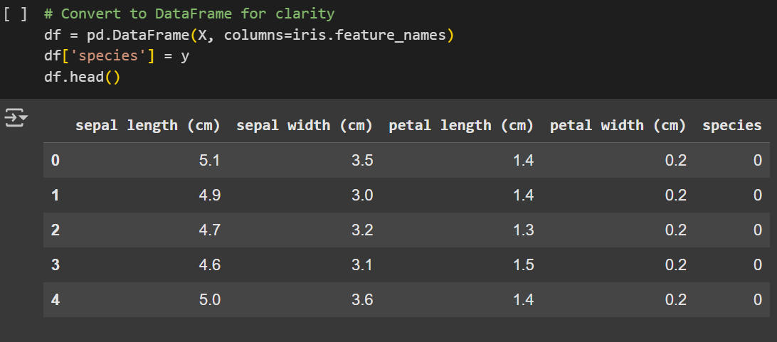
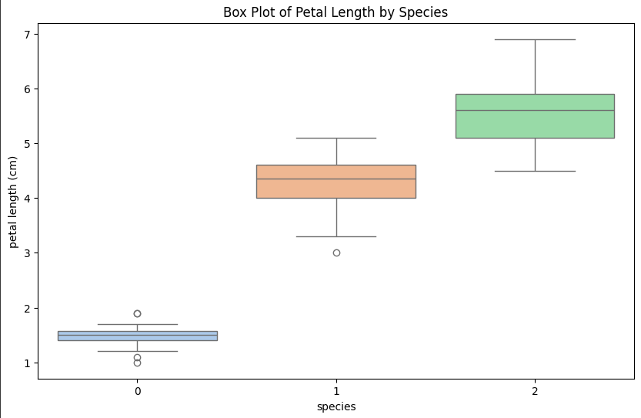
About the data
In the data we can see the different types of the columns that give the all information about the data and the columns names in the data set
The box plot provides a clear comparison of petal lengths across different iris species. It shows that each species has a distinct range of petal lengths, with Iris virginica 2 having the longest petal lengths on average. This separate on indicates that petal length is a strong feature for distinguishing between species

Slide 6
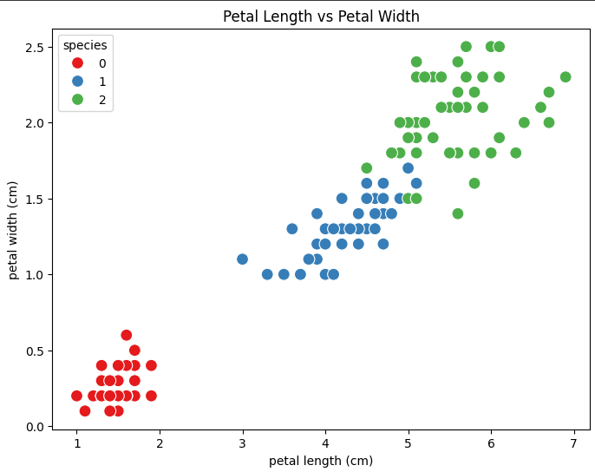
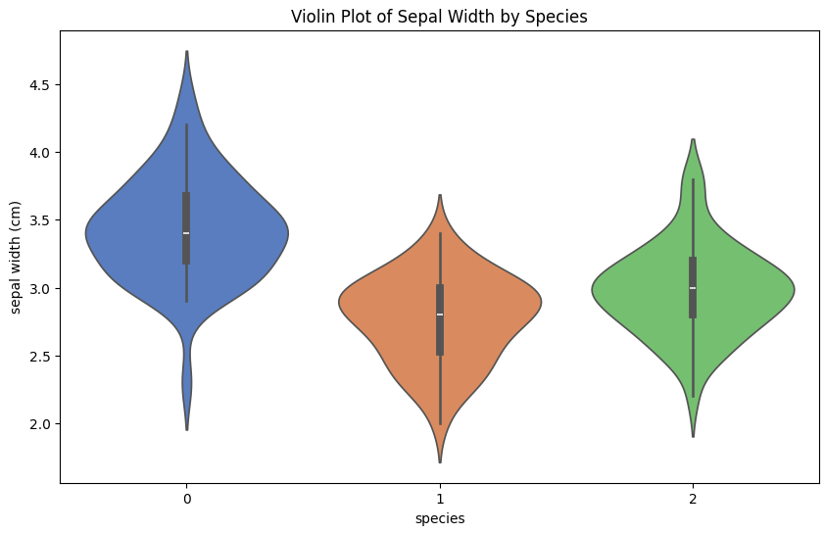
The violin and box plots illustrate the distribution of sepal width across the three iris species. These visualizations help highlight variations in spread and central tendency, showing how sepal width differs for each species. Additionally, the scatter plot between petal length and petal width reveals a clear separation among species, indicating that these two features are highly informative for classification

Slide 7
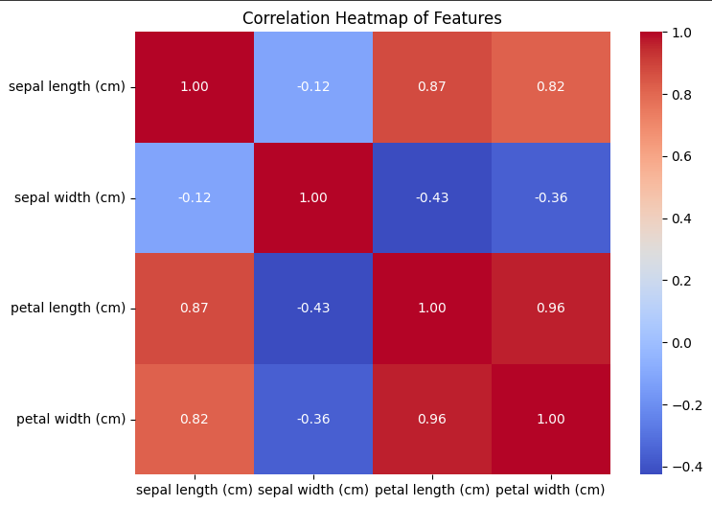
Age wise expenses
Correlation
The correlation heatmap visualizes the relationships between numerical features in the Iris dataset:
Petal length and petal width show a very strong positive correlation (0.96), indicating that as petal length increases, petal width tends to increase as well.
Sepal length also has a strong positive correlation with petal length (0.87) and petal width (0.82).
Sepal width, on the other hand, shows a weak or negative correlation with the other features, particularly with petal length (-0.43) and petal width (-0.36).
This analysis helps identify which features are most informative for classification, and it confirms that petal features are the most predictive in distinguishing iris species.

Slide 8
MODEL BUILDING
Logistic Regression is a widely used classification algorithm that is suitable for datasets where the target variable is categorical. The Iris dataset contains three species of flowers (Setosa, Versicolor, Virginica), making it a multi-class classification problem.
Reasons:
Simple and Interpretable: Logistic Regression provides easily interpretable results based on the relationship between features and class probabilities.
Efficient for Linearly Separable Classes: Some classes in the Iris dataset, especially Setosa, are linearly separable — making Logistic Regression a good fit.
Probabilistic Output: It gives probability estimates for each class, which is useful in evaluating model confidence.
Baseline Model: Logistic Regression serves as a good baseline model to compare the performance of more complex algorithms.
Performs Well with Smaller Datasets: The Iris dataset is small and clean, which suits Logistic Regression very wel

Slide 9
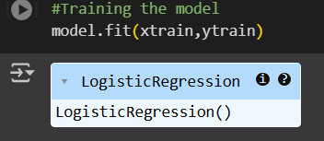
Logistic Regression
Logistic Regression is well-suited for the Iris dataset because it effectively handles classification problems, especially when the classes are linearly separable. The Iris dataset contains three flower species, and Logistic Regression can be extended to handle such multiclass classification using strategies like one-vs-rest. Its simplicity and interpretability make it easy to understand how each feature contributes to the final prediction. Since the dataset is small and clean, Logistic Regression trains quickly and performs efficiently. Additionally, it provides a strong baseline model to evaluate performance before moving on to more complex algorithms

Slide 10
About the fastapi
FastAPI is a modern, high-performance web framework for building APIs with Python. It is designed for speed and ease of use, allowing developers to quickly create RESTful APIs with automatic documentation and validation. Built on top of Starlette and Pydantic, FastAPI is ideal for data science and machine learning projects where API deployment is essential.

Slide 11

FastAPI for AI Engineering
🚀 What is FastAPI?
FastAPI is a modern, fast (high-performance) web framework used to build APIs with Python 3.7+.
It’s widely used in AI/ML deployment pipelines to expose models as RESTful APIs.
Built on Pydantic and Starlette, it ensures fast development and automatic validation.
FastAPI is a modern and high-performance web framework that plays a crucial role in AI engineering, particularly in the deployment of machine learning models. In AI workflows, once a model is trained, it needs to be made accessible for real-time use — this is where FastAPI comes in. It allows developers to quickly build RESTful APIs to serve their models so that external applications can send input data and receive predictions. FastAPI supports asynchronous request handling, built-in data validation through Pydantic, and automatic generation of interactive documentation using Swagger UI. Its simplicity, speed, and scalability make it ideal for AI tasks such as serving predictions, powering real-time recommendation engines, or integrating models into microservice architectures. For new AI engineers, FastAPI offers an efficient way to bridge the gap between model development and real-world usage

Slide 12


Steps to deploy in fastapi
Train the Model (e.g., using Scikit-learn)
To create a web application using FastAPI, the first step is to train a machine learning model. This can be done using libraries like Scikit-learn, which offers various algorithms for model training based on the dataset. Once trained, the model can be integrated into a FastAPI application to serve predictions.
Save the Model (joblib or pickle)
After training the model and making predictions on the test
data, the next step is to save the model for future use. This can be done
using libraries like pickle or joblib. In this project, pickle was used to serialize and save the trained model so it can be loaded later into the FastAPI application for serving predictions

Slide 13


Steps to deploy in fastapi
Create FastAPI App
After saving the trained model, the next step is to create a Fa
stAPI application. FastAPI allows us to build APIs where we can
define routes to send data and receive predictions from the model.
In this step, we load the saved model using pickle and create a FastAPI
app with an endpoint (usually POST) that accepts input data, runs the model’s
prediction, and returns the result..
Load the Model and Define Endpoints
Once the FastAPI app is set up, the saved machine learning model needs to
be loaded using the pickle library. This allows the model to be reused without retraining it every time
the API starts. After loading the model, we define API endpoints—usually a POST endpoint—to receive
input data from the user in JSON format. This data is then passed to the model for prediction, and
the output is returned as a response. These endpoints act as communication bridges between the model
and the outside world, enabling real-time predictions through a simple web interface or API call

Slide 14

Steps to deploy in fastapi
Run API with Uvicorn
After building the FastAPI application and defining
g the necessary endpoints, the next step is to run the API using a
server like Uvicorn. Uvicorn is a lightning-fast ASGI server that serves
the FastAPI app locally or in production. By using the command
uvicorn main:app --reload, we can start the server and access the API
through a web browser or API client like Postman. The --reload option is
useful during development, as it automatically updates the server when code
changes are made. This allows for smooth testing and interaction with the deployed model.

Slide 15
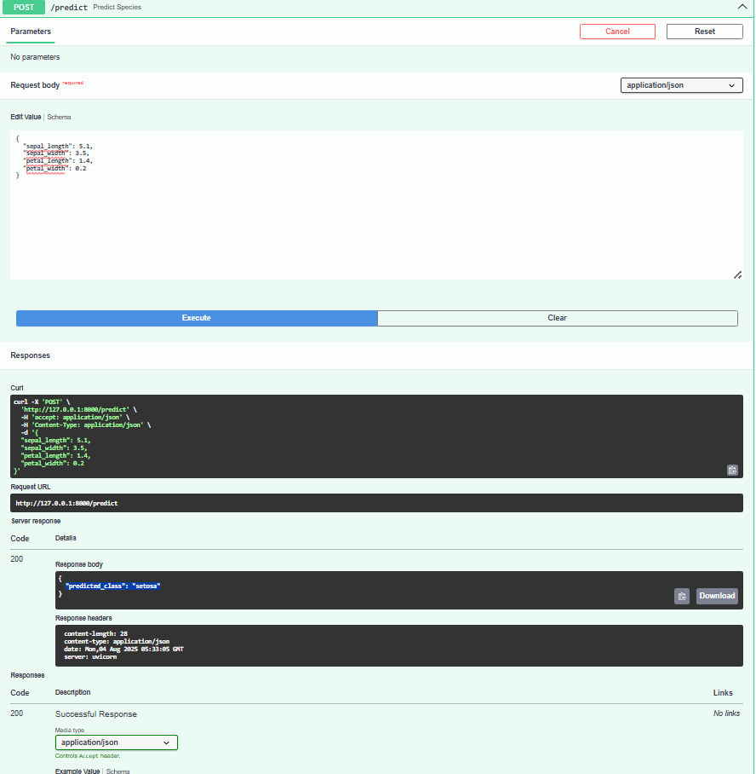
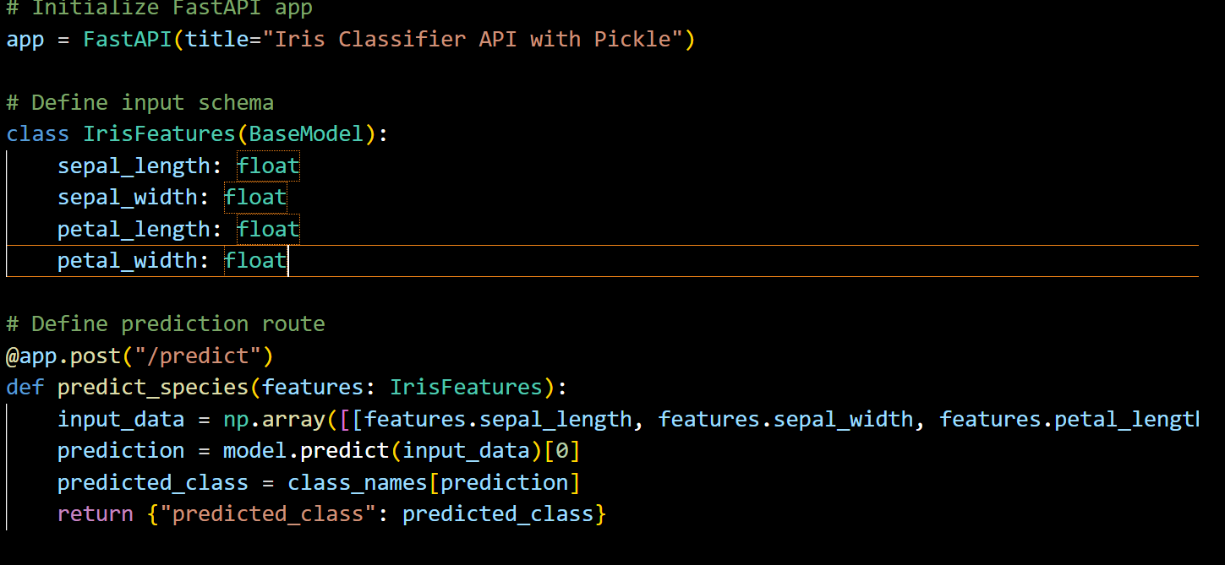
My deployment
In this project, I built a FastAPI-based web application to
classify Iris flower species using a machine learning mode
l trained with Logistic Regression. The core functionality of
the app is defined in Python using FastAPI and Pydantic. Th
e trained model is loaded using the pickle library. I created an input schema class
using BaseModel from Pydantic to validate and structure incoming data such
as sepal length, sepal width, petal length, and petal width. A POST endpoint /predict
is defined, which takes this input data, passes it to the model, and returns the
predicted class name (Setosa, Versicolor, or Virginica). The app is run locally using the
Uvicorn server with live reload capability. Additionally, FastAPI provides an
auto-generated Swagger UI to
test and interact with the API
easily, making the deployment
process both efficient and
developer-friendly

Slide 16

Challenges faced
As a beginner in FastAPI, one of the main challenges I faced was understanding how to structure the project and connect the trained machine learning model with an API endpoint. Initially, I struggled with loading the model using pickle and handling input validation through Pydantic. Debugging issues like incorrect module imports, API route testing, and running the app with Uvicorn also took time to resolve. Understanding how to use Swagger UI for testing API responses was new to me. Despite these challenges, working through them gave me hands-on experience with API development and helped me understand the end-to-end deployment pipeline of a machine learning model.

Slide 17

THANK YOU

